Slide 1

IST346: Storage and File Systems

Slide 2

Agenda
Discussion
Content
Disks
Storage
File Systems
Wrap-Up

Slide 3
Discussion Questions
How many Megabytes in a Terabyte?
What is the difference between a Hard Disk and an SSD?
How many levels of redundancy are in RAID5?
Of NAS, SAN and DAS, which technology uses a dedicated proprietary network?
Why is it that the more disks you include in a storage array the greater the chance of failure?
Which SAN technology uses TCP/IP?
List two Services which allow for the sharing of files over a network?
Notes:
Give students 1-2 minutes for each question. Its important to provide them with the opportunity to answer the questions based on the reading, labs, and assigned homework.

Slide 4

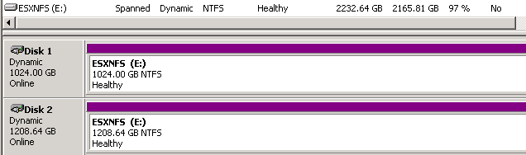
Partitions and Logical Volumes

Slide 5
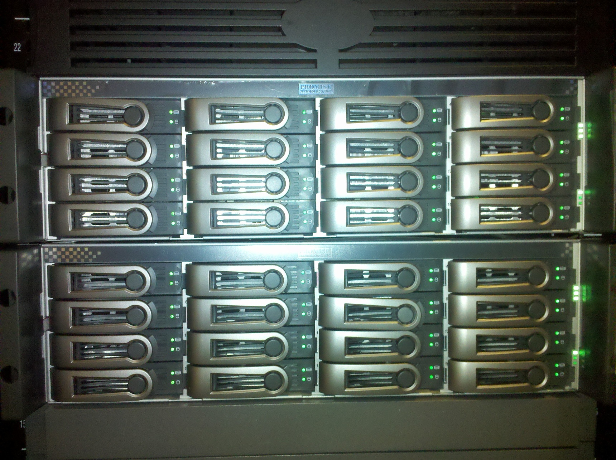
Disk Arrays

Slide 6
RAID

Slide 7
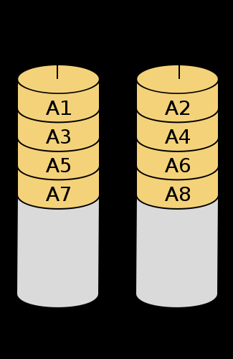
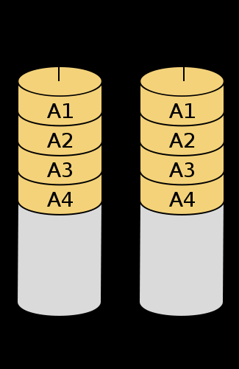
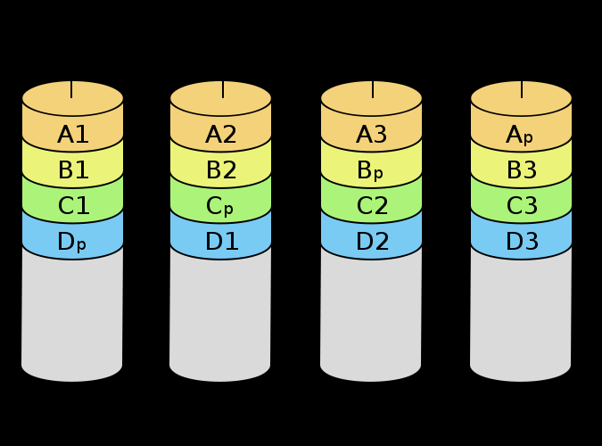
RAID Levels (most common)
Level | Description | Min # Disks | Space Efficiency | Fault Tolerance?
0 | Striping | 2 | N | No
1 | Mirroring | 2 | 1 | Yes
5 | Parity Striping | N | N-1 | Yes
6 | Dual Parity Striping | N | N-2 | Yes
10 | Mirrored Stripe | N (Even) | N/2 | Yes
RAID0
RAID1
RAID5

Slide 8
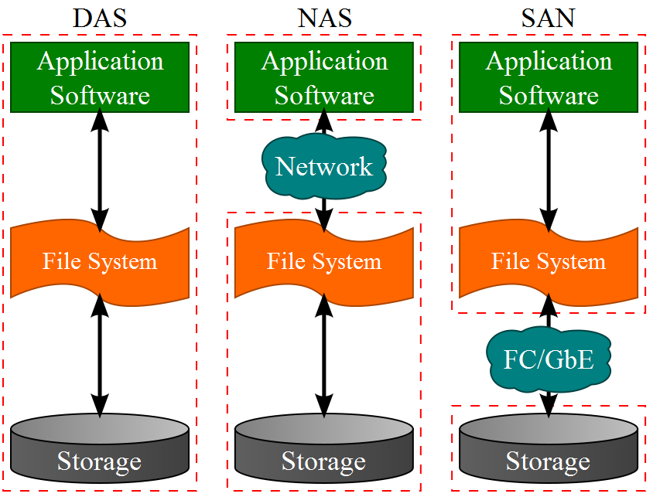
Storage Systems

Slide 9
Group Activity
Array Capacity and MTBF

Slide 10
Details of Group Activity
Divide into pairs.
You have a storage array which has 16 1TB drives in a RAID 10 configuration. The mean time between failure of any drive is 1 Million hours
Calculate the total capacity of the array
How many drives can fail before the array is unusuable?
What is the MTFB for the array? (When can you expect one drive to fail?)

Slide 11

Your To-Do List
What to work on for next class
Notes:
ALWAYS CONSULT THE SYLLABUS

Slide 12

Exit Ticket
Share one thing you learned today that you didn’t know before class!

Slide 13

Questions?

